Slide 1
Introduction to Sociology Class 11 September 2023
Jan D. Reinhardt
伊恩

Slide 2
Preliminary topics and schedule
Complexity, meaning, communication, consciousness
The omnipresence of the other I, strangers and strangeness of society
Self and society
Do animals have societies and consciousness?
Social facts and sociological methods
Social roles
Norms and deviant behavior including crime, bullying etc.
Individuals, families, organizations
Love, marriage, sexuality
Art (music, literature, painting etc.)
Technology
Dialectics of authority, rationality, and history
Body, sickness, and medicine
Mass media and new social media
Consciousness and (false) memories
The society of the society (Niklas Luhmann's systems theory)
Any other suggestions???

Slide 3
Evaluation mode
Integrated student presentations/debates
Teams of 2-4 students with 15-30 minutes allocated time
Topics can be selected from list or freely suggested
Topics can always be suggested
Teams can already form now on
Topic selection starting from week 3 on
Teams presenting earlier get bonus scores
Teams will have the opportunity to discuss with the teacher in advance
Out of class tutoring upon appointment
Forums will be created on Black Board, WeChat, etc. to suggest, select, and discuss topics
Comments/suggestions

Slide 4
Other updates
Book Richard Munch: Sociological theory will be made available asap
Other literature will be provided based on topics selected by students and arising in discussions
Please don’t hesitate to make comments on WeChat group, also during class/lecture …
Interrupt me if anything is

Slide 5
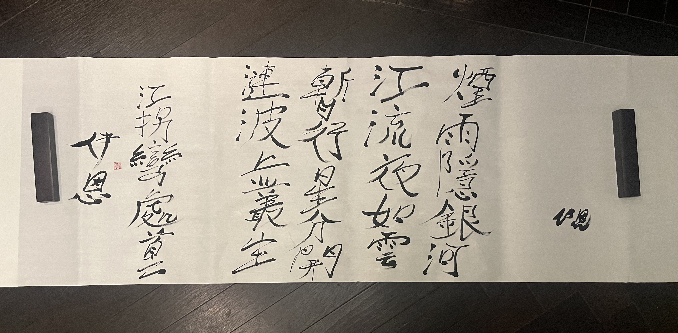
Complexity

Slide 6
What does that mean? What is meaning?

Slide 7
It is not snow: meaning as the fundamental human mechanism to reduce complexity
As opposed to structures of the organism confining perception, instincts etc.
梅花
王安石
墙角数枝梅，凌寒独自开。 遥知不是雪，为有暗香来。
Art reduces complexity to re-introduce complexity to reduce complexity of the complexity problem

Slide 8
Meaning
Difference between focus and horizon that is made current/actualized at a moment in time
Essentially operating binary
Not snow (or something else) but a flower, not snow willow catkin(or some other tree blossom) but a plum flower, not white (or another color) but red, etc.
Interlocked, nested, and overlapping schemes/categories constitute the realm within which meaning is operated
Art crosses from focus to horizon and questions the very schemes and is thus essentially innovative (or even deviant)

Slide 9
What is information?

Slide 10
Information
Is a difference that makes a difference (Bateson)
香来 -> 梅花
Why香来?
As opposed to 明来?

Slide 11
Information and meaning
Has consequences
Triggers a follow-up processing
It draws a line that is to be crossed or not
Does not necessarily operate in the realm of meaning
Tic example
Meaning can only be processed by social or conscious systems

Slide 12
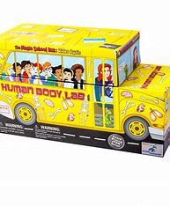

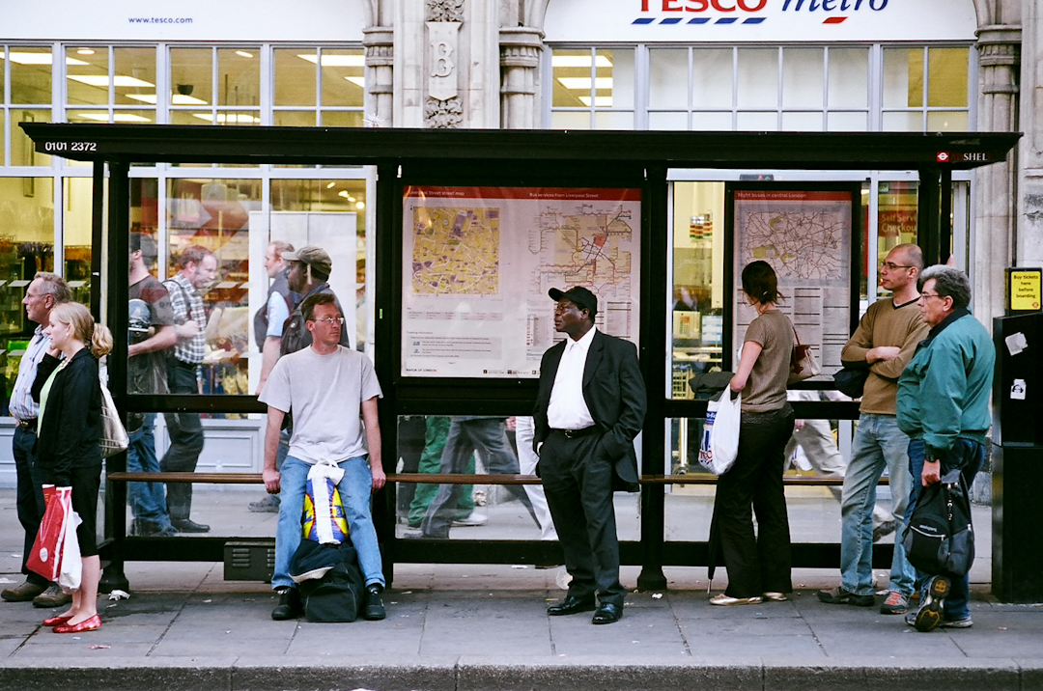
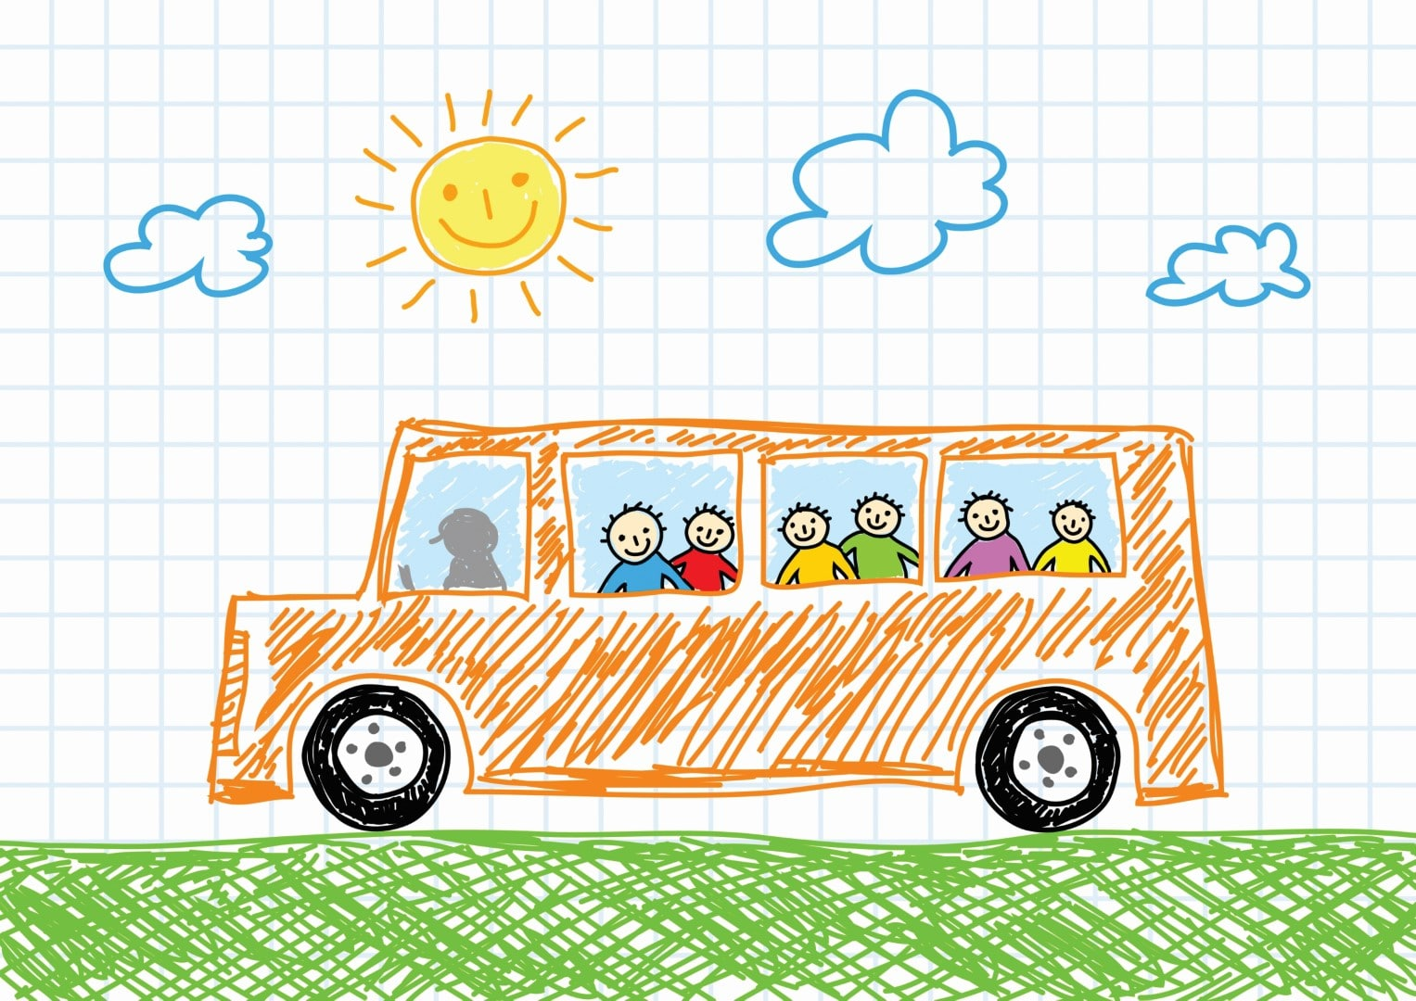
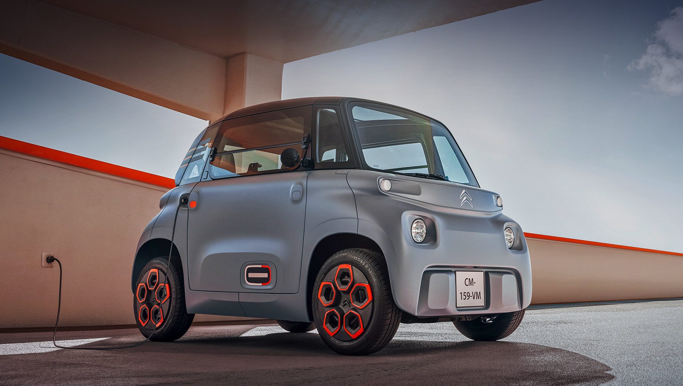
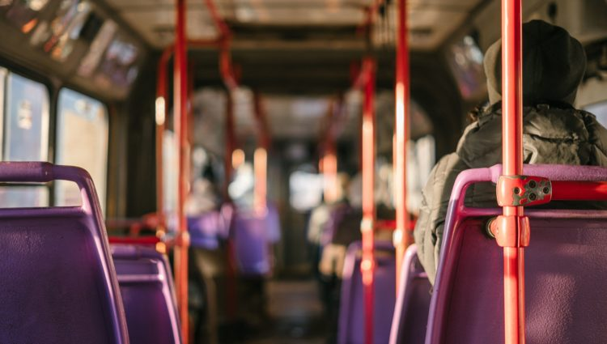
How many pictures have a bus?

Slide 13
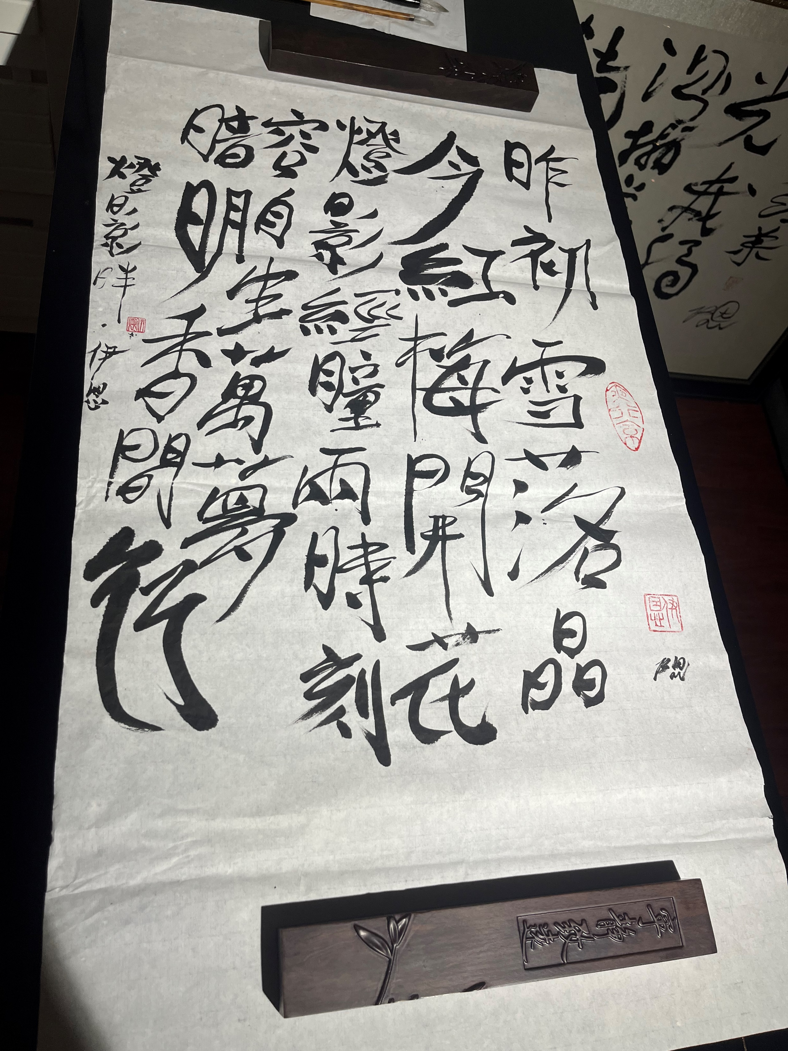
Innovation as crossing from focus to horizon and dimensional extension of binary space
灯影畔
昨初雪落晶
今红梅开花
灯影经瞳两时刻
容自生万梦
暗明香间行

Slide 14
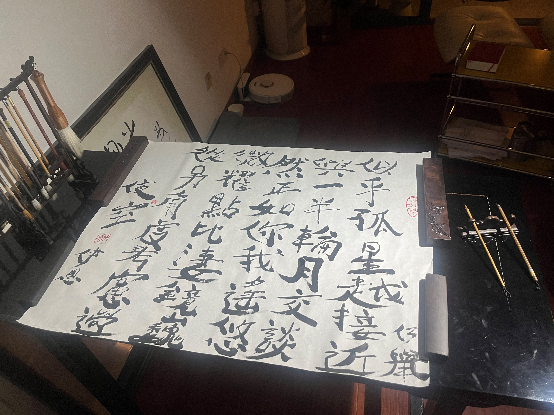
Observer perspective

Slide 15
Observer
How meaning is processed depends on observer perspective
Who observes with which differentiation drawing or crossing which line

Slide 16
Communication vs consciousness
What about Trisolarian society (三体)?
Vulcanian mind fusion (Startrek)?
Can that work?

Slide 17
Communication
Communication essentially processes differences between (meaningful) information and messages that make a difference for follow up conversation
The message aspect implies addresses (receivers and senders)
A student is yawning …
So what?
How to interpret?
When does it become communication?
The addresses are themselves constructed by communication

Slide 18
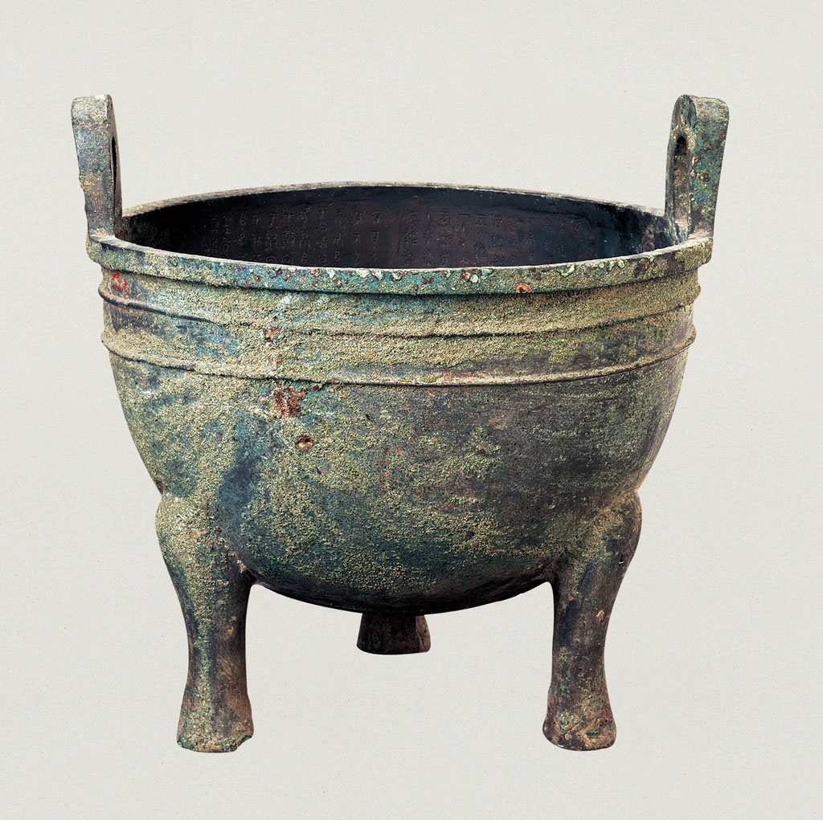
多友鼎

Slide 19
Consciousness
What is it and how is it different from communication?
Does consciousness imply self-consciousness?

Slide 20
Consciousness
Is a perception system that operates with meaning
Co-evolves with communication systems
Implies being addressed as a person and thus development as self-consciousness
Can process in language, pictures, emotions etc
Diachronic vs. synchronic

Slide 21
Do animals have consciousness?

Slide 22
Do animals have consciousness?
Crow example
Memorize what is where, at which time to which effect…
Difficult to tell …

Slide 23
Society
Is a system encompassing all communications
within some (more or less) confined geolocation (pre-modern)
Or worldwide (modern, post-modern)
Consists of different coupled nested and non-nested social systems, such as family, companies, universities, politics, legal system, art etc.

Slide 24
For us society is always already there
Hedgehog and rabbit

Slide 25
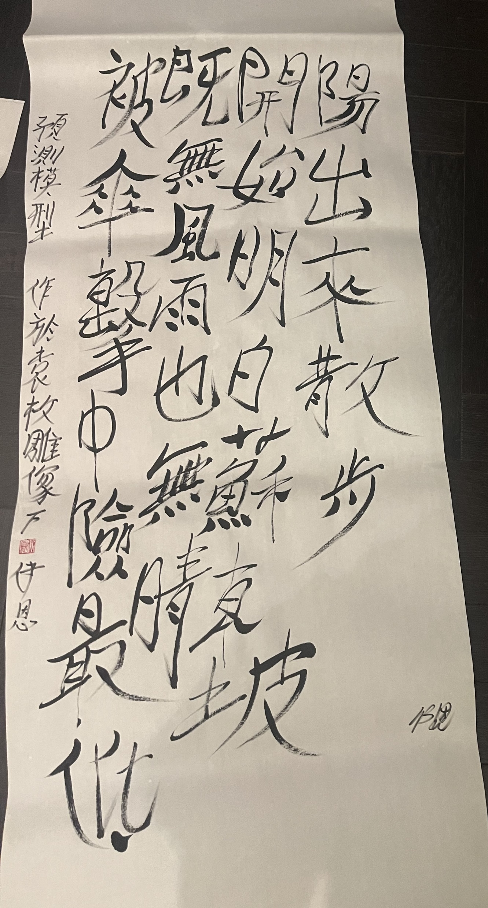
They got umbrellas
Action
Vs.
Social action (M Weber)

Slide 26
What others are there in your life? What do they mean for you? What feelings can they cause?

Slide 27
The others: Pleasure and pain
You are my sunshine
为爱痴狂

Slide 28
The others: confinement through superiors in an organization
早秋苦热堆案相仍
七月六日苦炎蒸，
对食暂餐还不能。
常愁夜来皆是蝎，
况乃秋后转多蝇。
束带发狂欲大叫，
簿书何急来相仍。
南望青松架短壑，
安得赤脚踏层冰。

Slide 29
The others: confinement through hierarchy and culture
酒桌化文 • 伤得面目全非
人被困在圆桌围，
假装都文明，
让幼友飘飘周围，
克服距示立排名，
认为子美写春雨，
雨知顺眼未美味

Slide 30
The others: Threat
And I just turned twenty-two I was wonderin' what to do And the closer they got The more those feelings grew
Daddy's rifle in my hand felt reassurin' He told me, "Red means run son, numbers add up to nothin'" But when the first shot hit the docks I saw it comin'
Raised my rifle to my eye Never stopped to wonder why Then I saw black And my face splashed in the sky
Shelter me from the powder and the finger Cover me with the thought that pulled the trigger Just think of me as one you'd never figured
Would fade away so young With so much left undone Remember me to my love I know I'll miss her
Powderfinger (Neil Young)
Look out, Mama, there's a white boat comin' up the river With a big red beacon and a flag and a man on the rail I think you'd better call John 'Cause it don't look like they're here to deliver the mail
And they're less than a mile away I hope they didn't come to stay It's got numbers on the side and a gun And it's makin' big waves
Daddy has gone, my brother's out hunting in the mountains Big John's been drinking since the river took Emmy Lou So the powers that be left me here to do the thinkin'

Slide 31
Others
Significant others
Generalized other
Play
Game
Norms

Slide 32
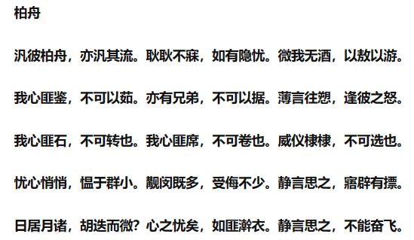
The self arising through and in opposition through others
诗经26《柏舟》

Slide 33
Do we know the others at all?

Slide 34
Ask your parents
How was work?
Were you better than the other employees?
Did you make new friends?
Did you eat lunch?

